Slide 1


NOVEMBER 2019
Marketing Analytics of O-List
Aditya Shetty
Mohammed Saqib Asghar
Ravikiran Bobba
Sharang Wakankar
Shivang Arya

Slide 2
About O-list
Brazilian e-commerce startup connecting merchants with wider marketplaces since 2015.
Provides logistics and collaborates with “brick-and-mortars” (traditional street-side stores) to give them an online presence.
Provides services like strategic digital marketing campaigns in the main marketplaces where it operates, delivery and even after-sales.
O-list also aggregates products for other major online marketplaces. Some of these include Amazon and Via Varejo.

Slide 3
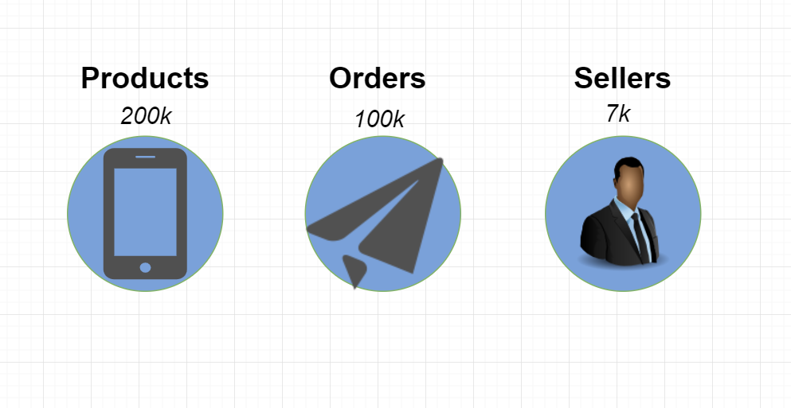
About O-list - Market Overview

Slide 4
Project timeline
23rd Sep 2019
30th Sep 2019
9th Oct 2019
23rd Oct 2019
Initial Discussion of the project
Project Proposed to Professor
Professor Approves the project
O-list raises 42 M USD in Funding

Slide 5
Project Goals
Which cities are performing well?
Which regions are to be targeted for expansion?
Which category of products are highly favored by the customers?
What are different consumer segments and strategies can be used to improve GMV?
What are Effective Channels for seller acquisition?
What is the lifetime value of seller? Which categories have higher value per seller?
Consumer Acquisition
Seller Acquisition
Senior Management
Operations
What is the monthly sales forecast for the company?
What is the optimal plan for marketing to increase revenue to the company?
What is effect of order delivery time on number of orders and GMV?
What is the forecast of number of orders?

Slide 6
Customer Acquisition

Slide 7
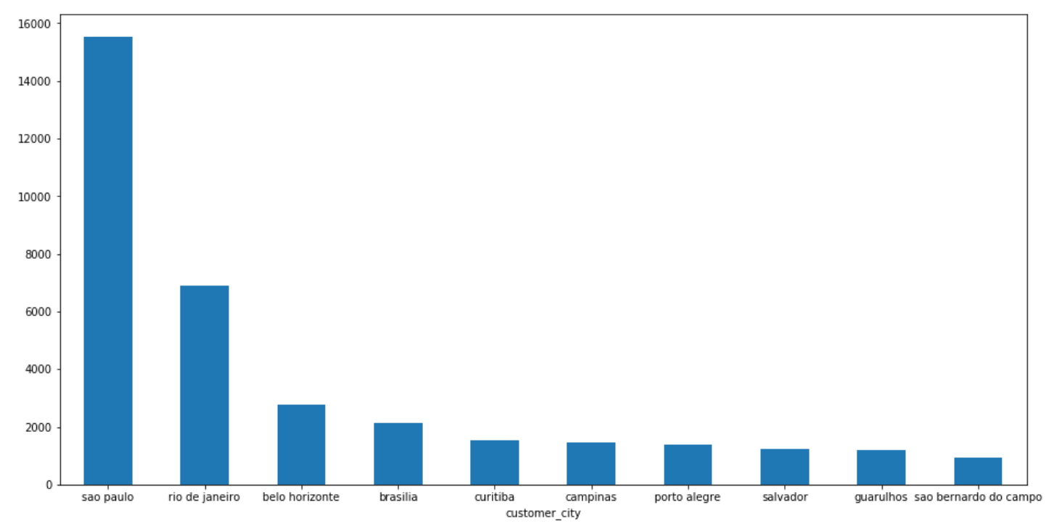
Top 10 Cities - Number of Unique Customers
Number of unique customers: 96096
Number of unique cities: 4119
The most number of customers come from Sao Paulo.
This is the biggest city in Brazil as well as in the entire South America.
Unique Cities

Slide 8
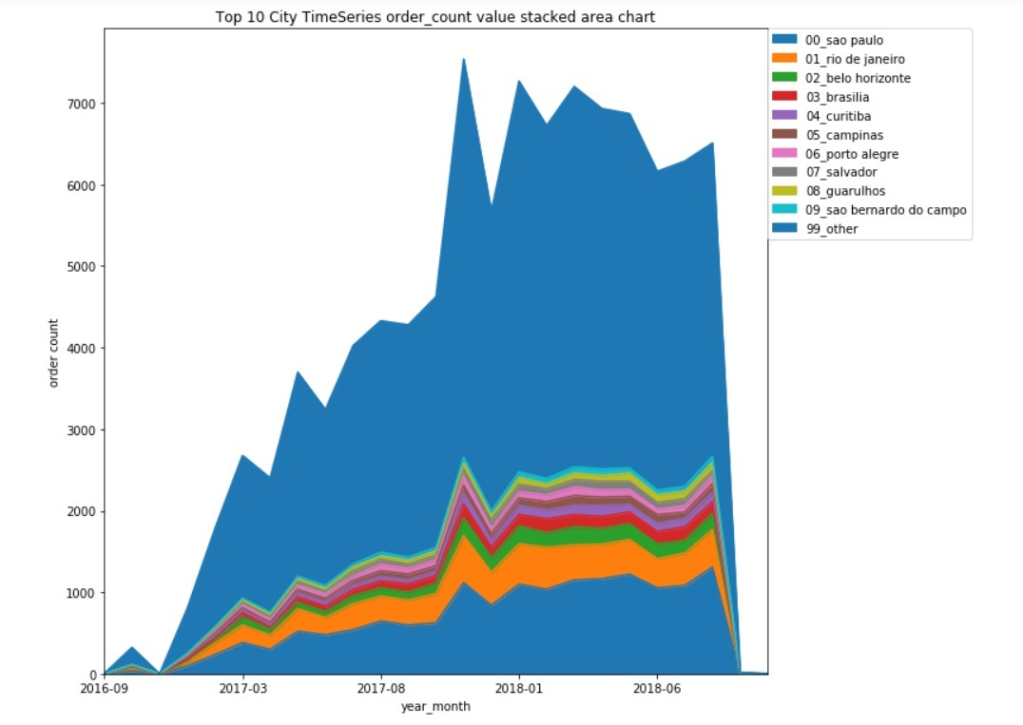
Top 10 cities - Order Count
Major cities like São Paulo and Rio De Janeiro have maximum order counts.

Slide 9
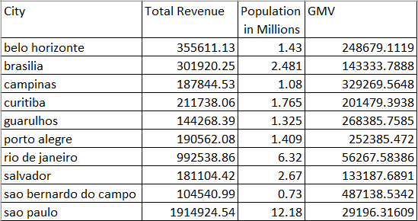
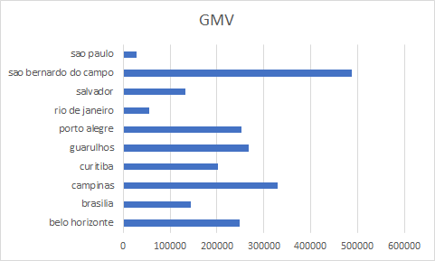
Gross Merchandise Volume
GMV - total sales dollar value for merchandise sold through a particular marketplace over a certain time frame.
High value customer belong to smaller cities even though the larger cities drive the major chunk of volume in terms of orders.

Slide 10
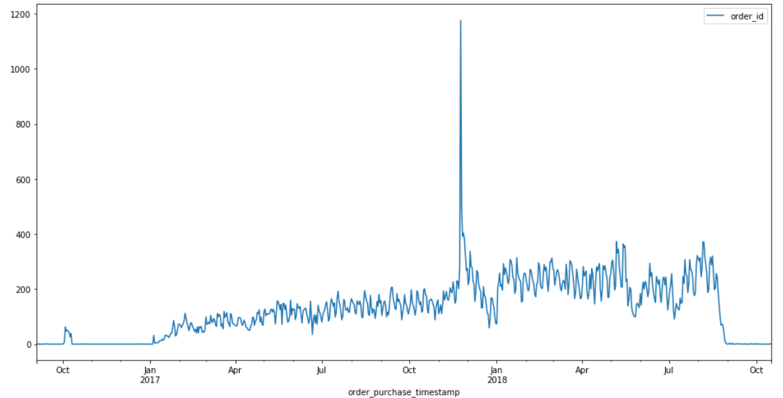
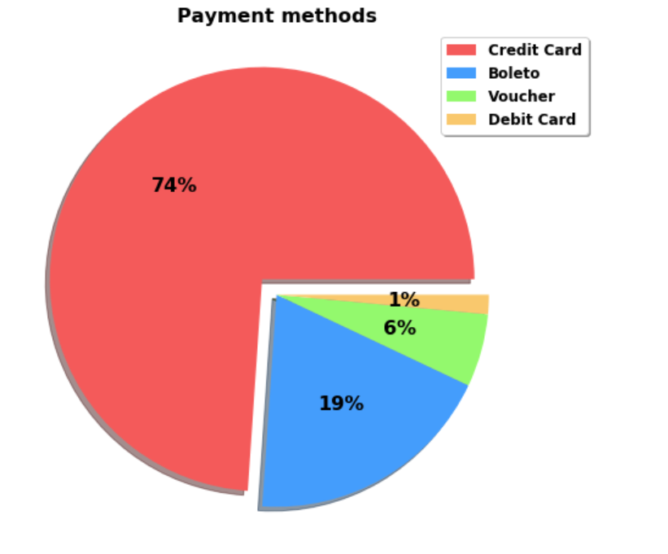
Order Count and Payment Method
The number of orders per month are generally constant except during the festive months like december.
Credit card is the major method for payment comprising about 3/4th of the orders.
Number of Orders

Slide 11
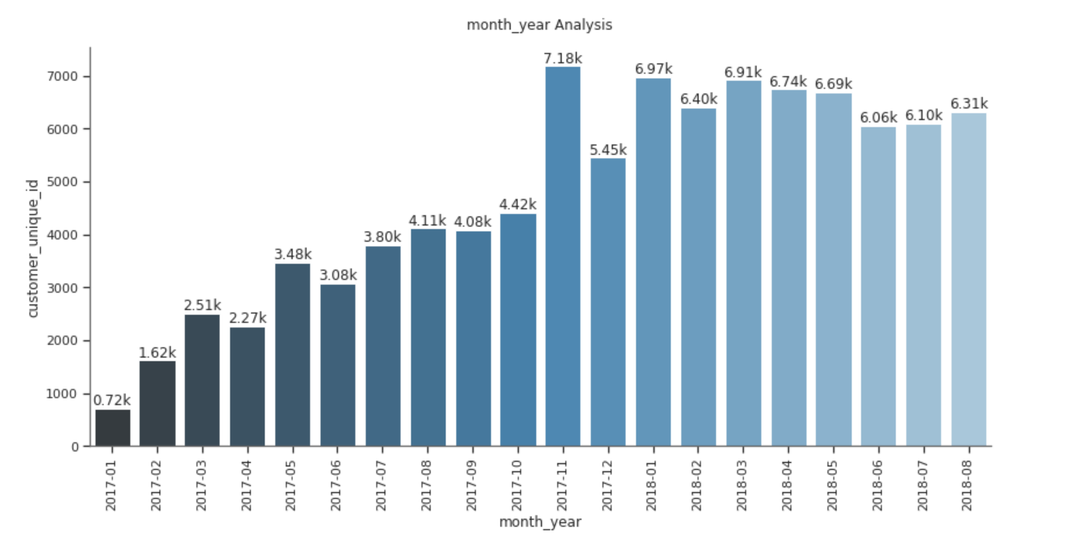
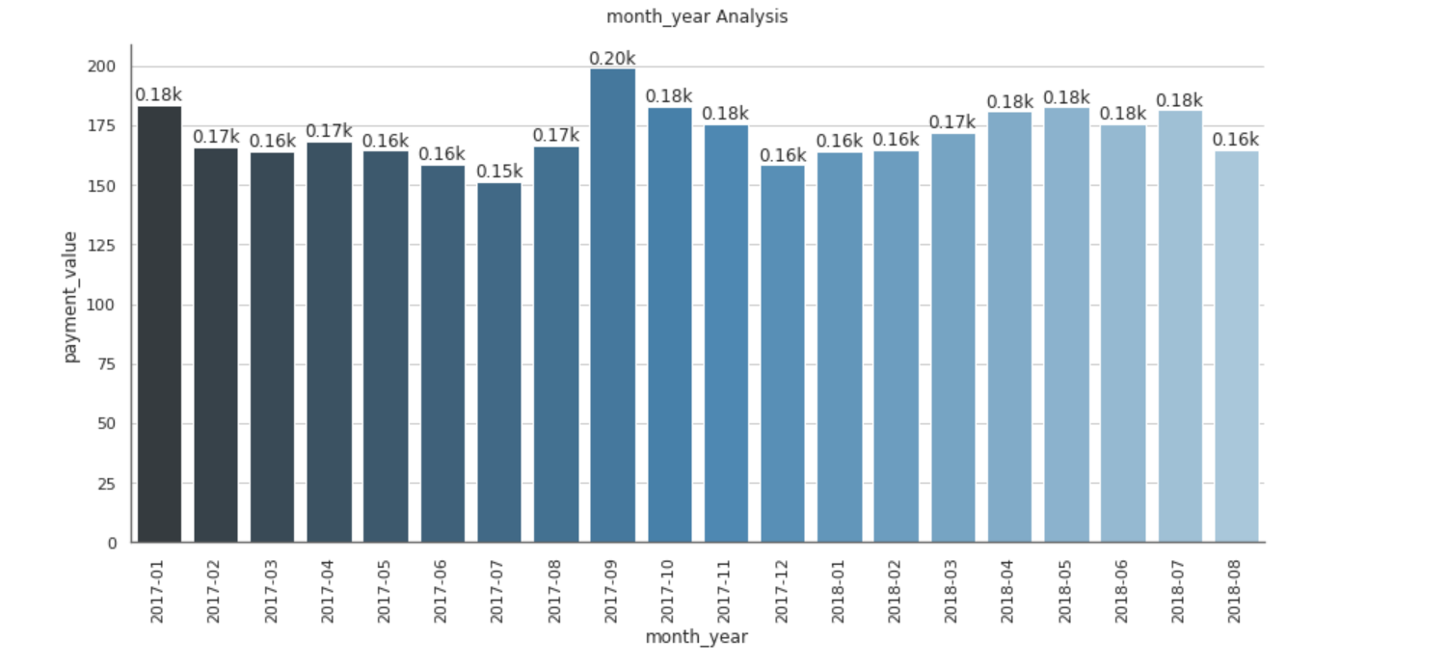
Customers and Revenue
Number of Unique Customers per month
Average Revenue per Customer

Slide 12
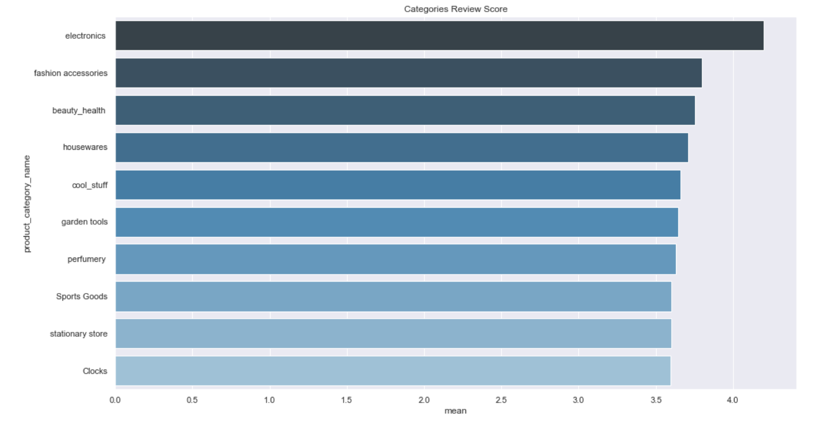
Top 10 Categories - Ratings
Electronic items are more favorably rated than other categories with a mean of 4.5.
It is followed by other common household and personal use items such as fashion accessories, beauty products.
It will be beneficial if Olist can keep track of the quality of products in these categories to strengthen trust.
Customer Ratings

Slide 13
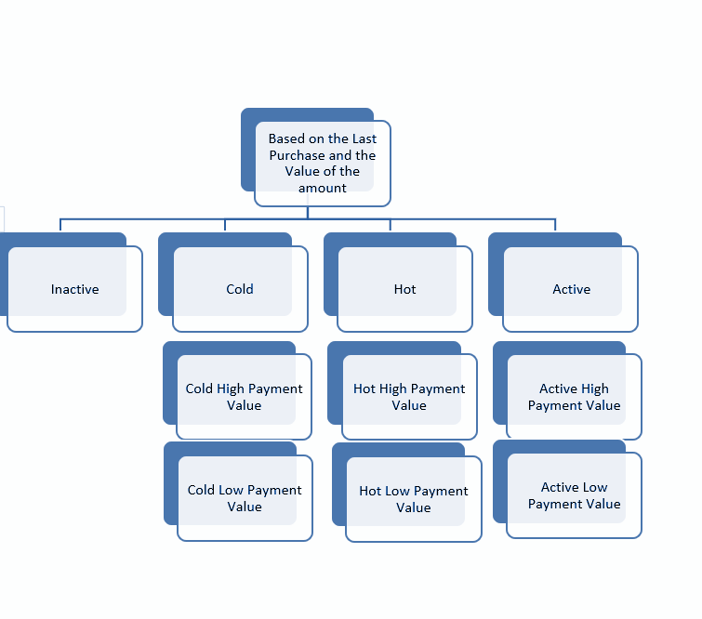
Customer Segmentation

Slide 14
Approach
Segment:
Inactive: Customer who did not make any purchases or that their last purchase was more than three times the period defined as a parameter.
Cold: Customer that your last purchase was greater than twice period and less than three times the period.
Hot: Customer that your last purchase was greater than the period and less than twice the period.
Active: Customer that your last purchase is less than the period.
Sub segment:
High Payment Value: Order payment above the median value.
Low Payment Value: Order payment below the median value.

Slide 15
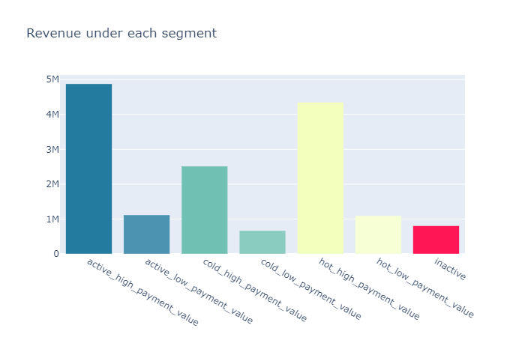
Customer Segmentation
Most of the revenue is brought in by the ‘Active’ segment followed closely by the ‘Hot’ segment.
The value brought in by the ‘Inactive’ segment is comparatively less.
They can try introducing a ‘Loyalty program’ to reignite the interest among the inactive customers and cold customer segments.

Slide 16
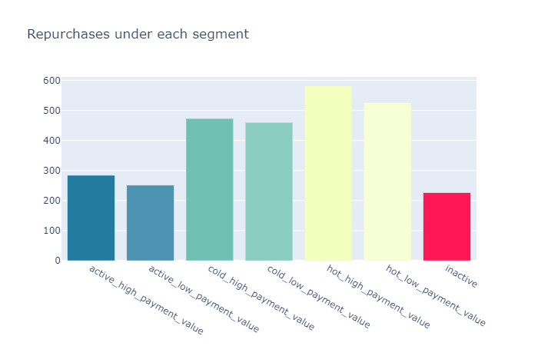
Customer Segmentation
Not many customers are willing to repurchase if they have bought any item in the previous 3-4 months.
To influence the active customers to
make a repurchase quickly, they can offer
targeted discounting on the previously
Purchased products.
The customers in the ‘Hot’ segment have more repurchases than other segments.
Notes:
Olist research

Slide 17
Seller Acquisition

Slide 18
Seller Lifetime value
Evaluating Seller lifetime value will help in
Identify categories with higher churn rates to take corrective actions
Understanding which categories to target for improving the GMV
Allocating resources for different categories to improve the overall revenue

Slide 19
Approach
Frequency of order is calculated based on performance of seller
A seller is assumed to be churned, if Today-last order month was greater than frequency for seller
Category level Margins and Churn percentages are calculated
Life-Time value is estimated with this margin and retention rate

Slide 20
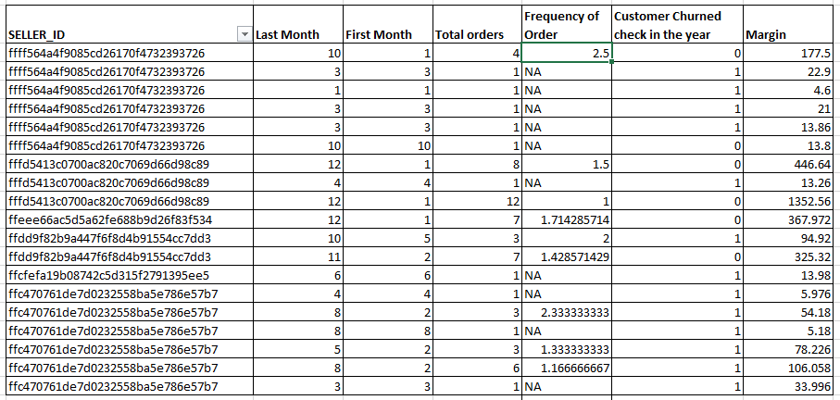
Churn Calculation

Slide 21
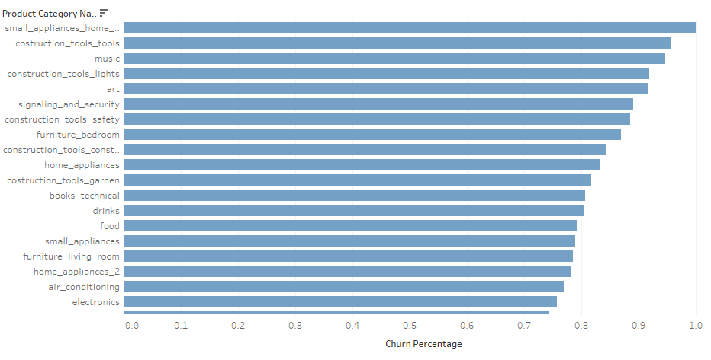
Category Level Churn Percentage

Slide 22
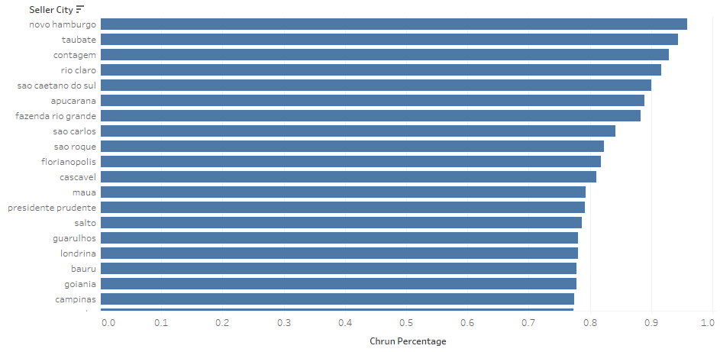
City Level Churn Percentage

Slide 23
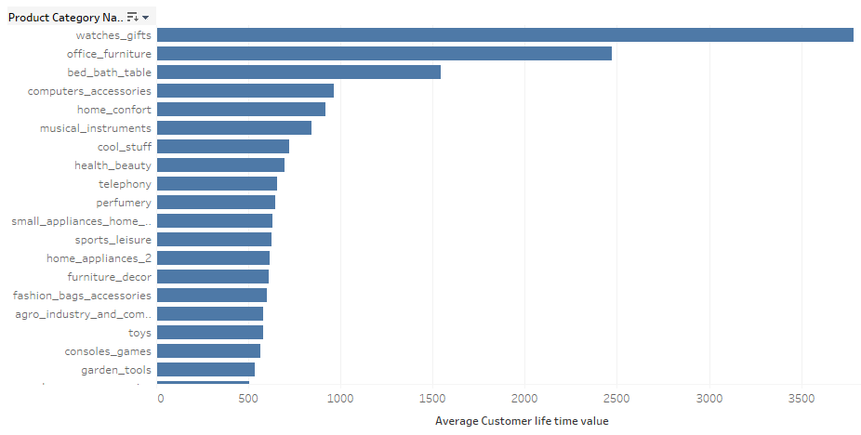
Category Level Seller Value

Slide 24
Leads and Channels
Marketing Qualified Leads
After a lead fills in a form at a landing page, a filter is made to select the ones that are qualified to sell their products at Olist. They are the Marketing Qualified Leads (MQLs).
8000 unique leads
Two important dates
First contact date: date of the first contact solicitation
Won date: date the deal was closed

Slide 25
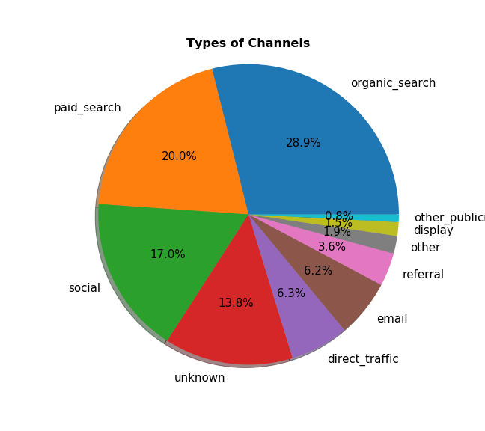
Leads and Channels
Channel: Type of media where the lead was acquired
10 different types of channels in the dataset
Paid Search and Organic Search the most common

Slide 26
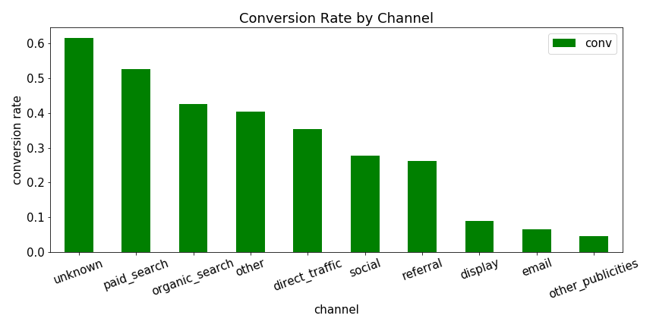
Leads and Channels - Conversions
Which channels are the most favorable for conversion of leads?

Slide 27
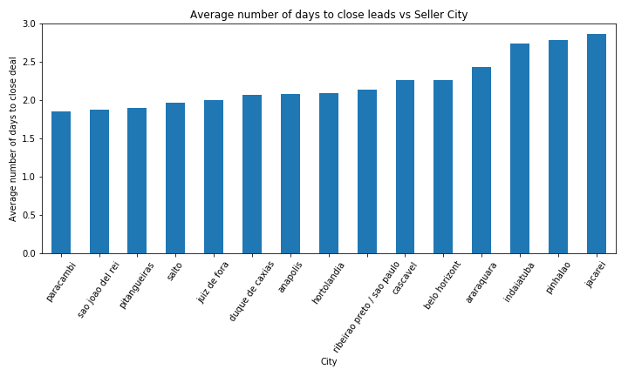
Leads and Channels - Top Performing Cities

Slide 28
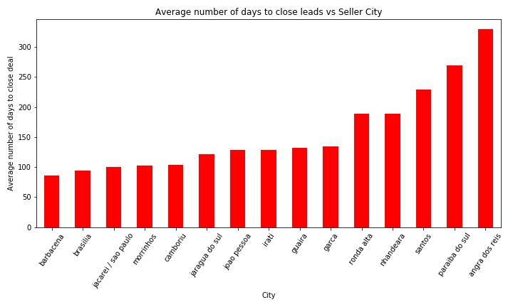
Leads and Channels - Under Performing Cities

Slide 29
Leads and Channels - Cities Analysis
Olist should look to expand operations in the cities from the ‘Top Performing Cities’ chart. Particularly, in Paracambi, Sao Joao del Rei, and Pitangueiras, there are sellers that have some of the fastest times nationwide when it comes to converting leads to closed deals.
Conversely, there are sellers in cities such as Angra dos reis, Paraiba do sul, and Santos that take considerably long periods of time to convert a lead into a closed deal. Olist can either close operations in those cities or hire more Sales Development Representatives to reduce the closing times, depending on the potential of market growth in the city.

Slide 30
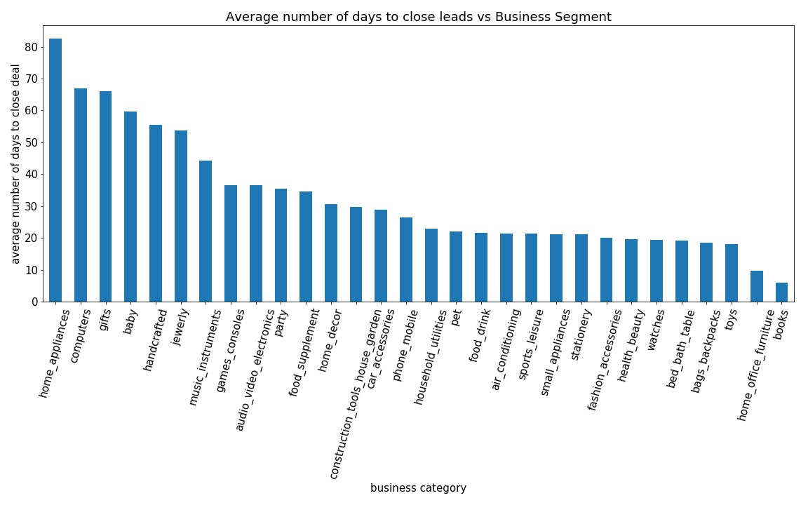
Leads and Channels - Business Segments

Slide 31
Leads and Channels - Business Segments
Top 5 segments:
Religious, books, home office furniture, toys, bags/backpacks, and handcrafted
Bottom 5 segments:
Perfume, home appliances, computers, gifts, baby, and bed/bath/table
Remove outliers:
In the case of religious segment, there is only one order.
In the case of perfume segment, there were only two orders.

Slide 32
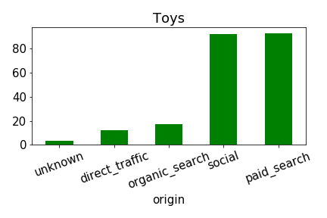
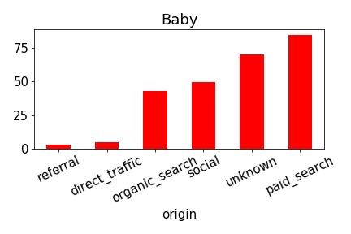
Leads and Channels - Toys vs Baby

Slide 33
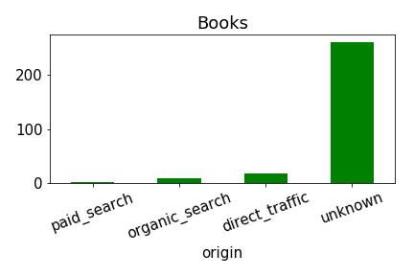
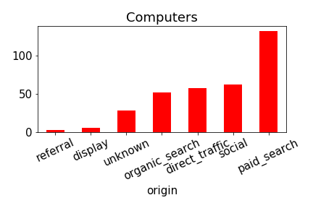
Leads and Channels - Books vs Computers

Slide 34
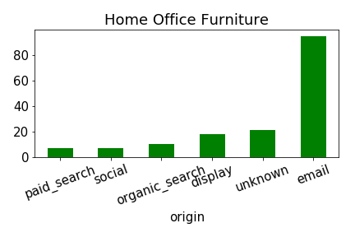
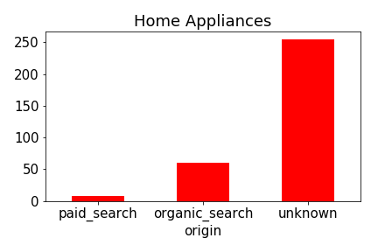
Leads and Channels - Home Office vs Home Appliances

Slide 35
Leads and Channels - Business Segments
In general, within top performing cities, deals are being closed faster due to the usage of more channels
Most channels employed are favorable for conversion of leads
In general, within under performing cities, deals are being closed slower because fewer channels are utilized
Only one or two channels employed are favorable for conversion of leads

Slide 36
Operations

Slide 37
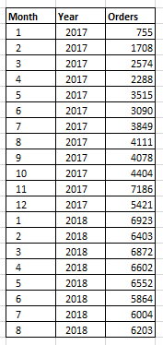
Approach
We observe that the number of orders varies with respect to time
Might be able to fit a time series forecasting model to this data
Maybe the Holt Winters forecasting model

Slide 38
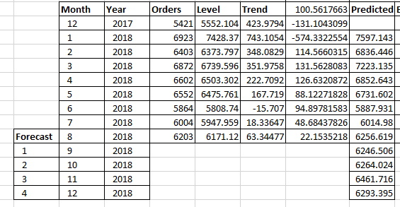
Level, Trend and Seasonality Forecast

Slide 39
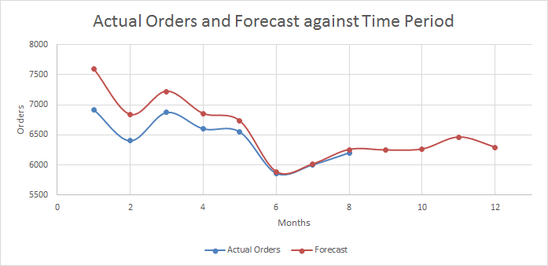
Monthly Forecast of Orders

Slide 40
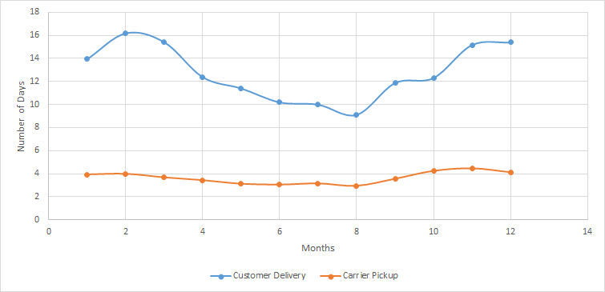
Average Monthly Delivery Time

Slide 41
Insights and Recommendations
As the delivery time goes down, the number of orders increases (except later in the year presumably because of festivals)
Carriers take 3 days on an average to pick up the orders and then roughly 10 days to deliver it. This can potentially be minimized as a lower delivery time increases the number of orders
Identify and correct issues at the carriers end
Incentivize using discounts and offers in the months where number of orders is low and/or the delivery time is high (eg. Feb, June and Oct)

Slide 42
Senior Management

Slide 43
Can we make a time series forecast for Sales?

Slide 44
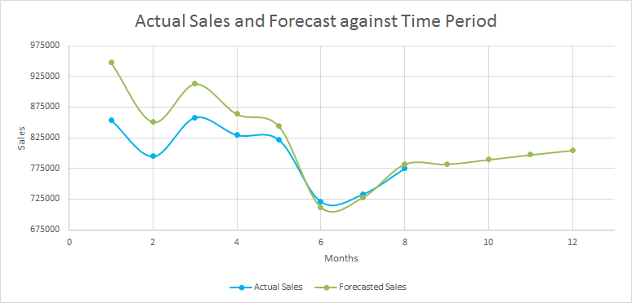
Monthly Sales Forecast

Slide 45
Insights
Forecasted Sales of the next few months:
September: 782,107.8
October: 789,628.1
November: 797,597.9
December: 804,726.4
We expect a spike in sales in the months on November and December which the firm can capitalize on.
Notes:
Capitalization: Be prepared for operations, get the carriers in check to ensure timely delivery, aggregate more products so that the customers have multiple options to choose from

Slide 46
Can we combine a bunch of stuff we saw above to get an Optimal Marketing Plan?

Slide 47
Optimal Marketing Plan
Cost Per Lead for Different Marketing Channels
Conversion % for each Marketing Channel
Optimal Marketing Plan for O-List
Plan with intricate details on how a particular marketing budget should be split across different Channels and Business segments
% Channel Level converted Lead Split per different Categories
Seller Life-Time Value for each Category

Slide 48
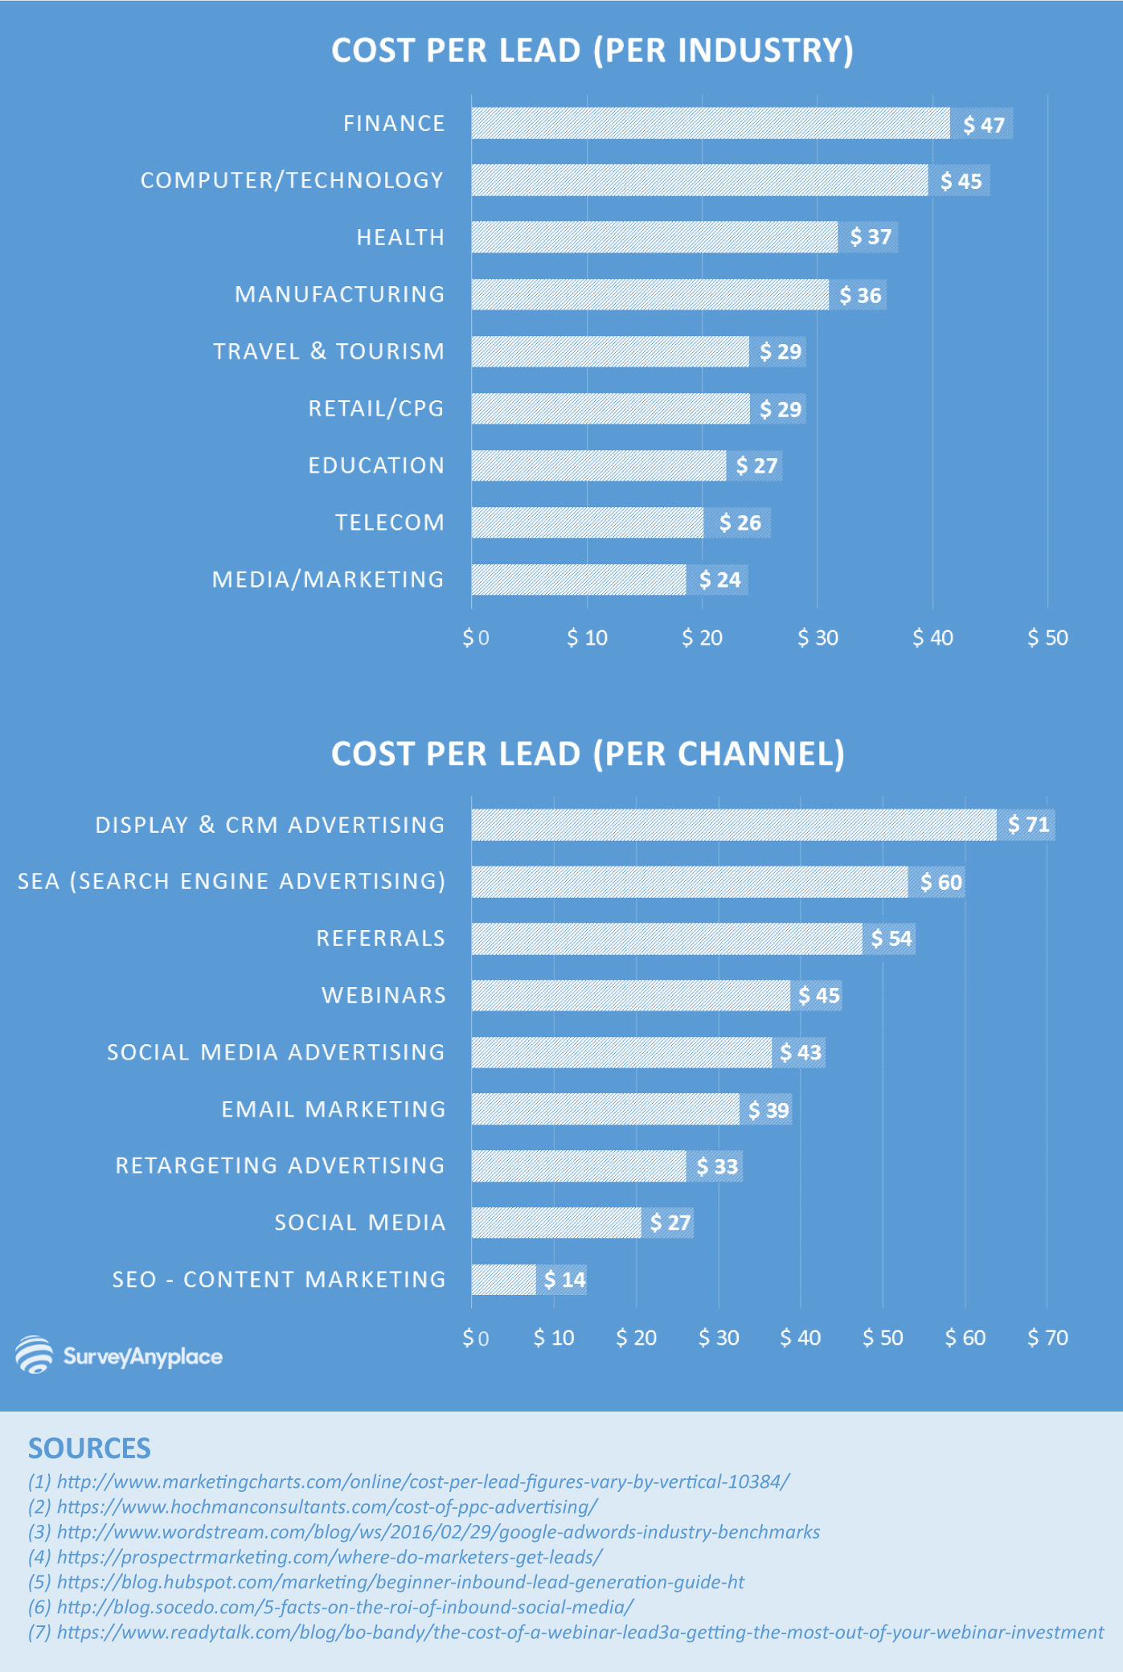
Channel level Cost per Lead
https://surveyanyplace.com/average-cost-per-lead-by-industry/

Slide 49
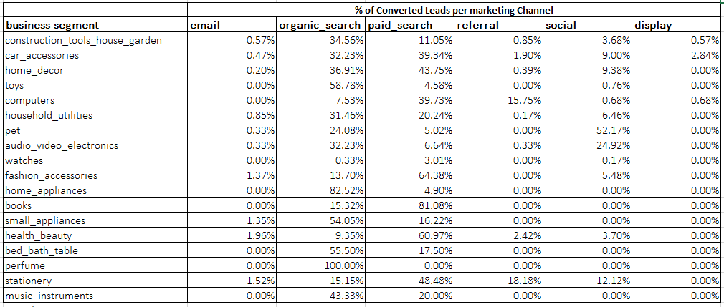
Percentage of converted leads across channels

Slide 50
Approach
Start with channel level split of converted leads, identify one standard channel, and calculate all other channels ratios w.r.t this category
Calculate the Number of leads required by dividing the Converted Sellers by Conversion percentage of that particular channel
Calculate the cost required for acquisition of these leads, by multiplying with CPL
Calculate the Total cost and Total value by aggregation across all categories
Use solver to maximize the total value, by varying the initial assumption on number of converted leads by condition on total cost and a Max allocation per any of the categories

Slide 51
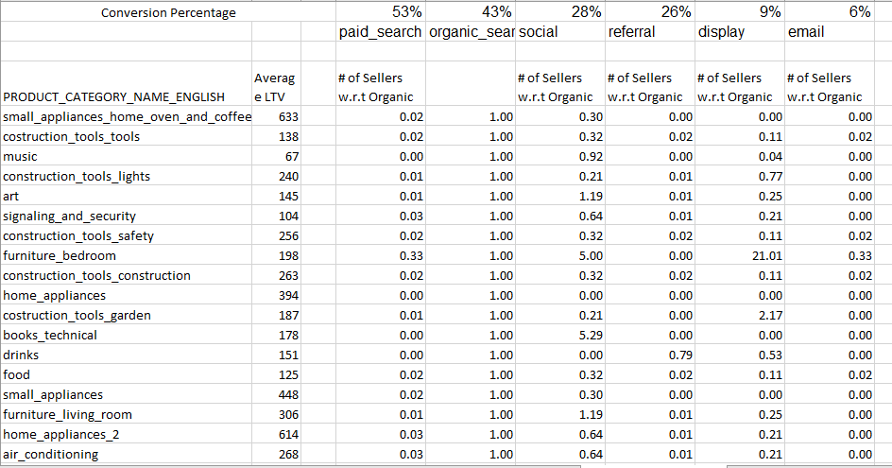
Step 1: Split of leads converted

Slide 52
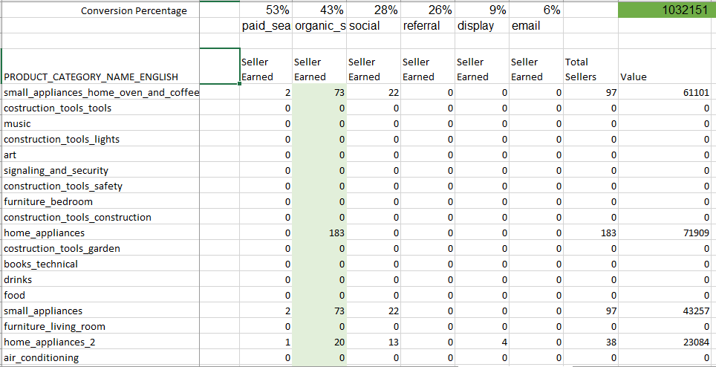
Step 2: Setting up for Maximisation

Slide 53
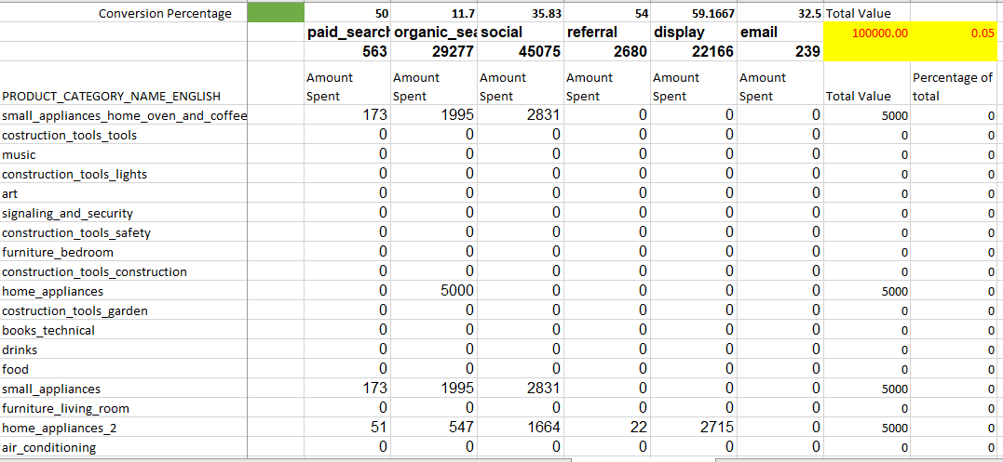
Step 3: Setting up for Conditions

Slide 54
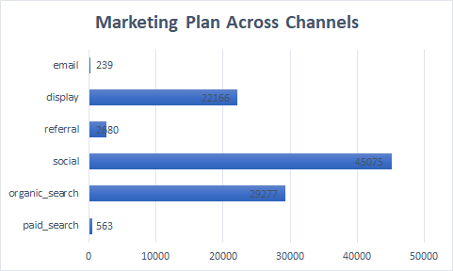
Results

Slide 55
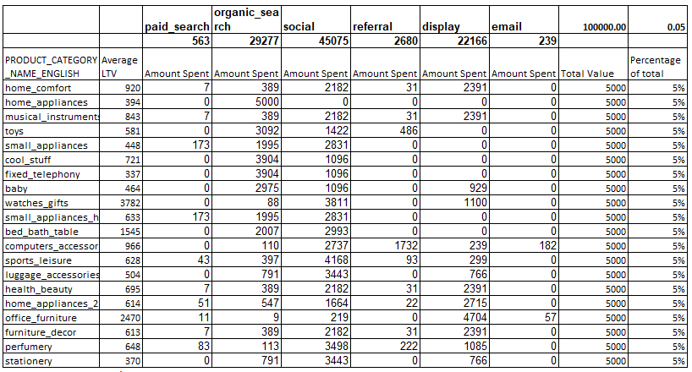
Category Level Channel Wise plan for Marketing

Slide 56
Conclusion
The Model considers all the possible factors which might affect the performance of Marketing and maximizes the Net value to the organisation
The Predicted Value to the organisation for a 100,000$ campaign is close 1.03 Million USD

Slide 57
Thank You

Slide 58
Appendix

Slide 59
Dataset Description
Link to the Datasets :
https://www.kaggle.com/olistbr/brazilian-ecommerce#olist_orders_dataset.csv
https://www.kaggle.com/olistbr/marketing-funnel-olist
Summary :The project has the collection of datasets with the customer details, order details, payments, lead acquisition channels, conversion of leads from Olist a major e-commerce player in Brazil.
These different sets can be combined to identify and analyse different business strategies/decisions which can be used to improve the overall performance of Olist.

Slide 60
References
Link to the References:
https://surveyanyplace.com/average-cost-per-lead-by-industry/ - Average CPL per channel and Category
https://www.marketingcharts.com/industries/business-to-business-47657 - B2B Channels for Lead Acquisition and rating in terms of cost

Slide 61
Industry wise Cost per Lead

Slide 62
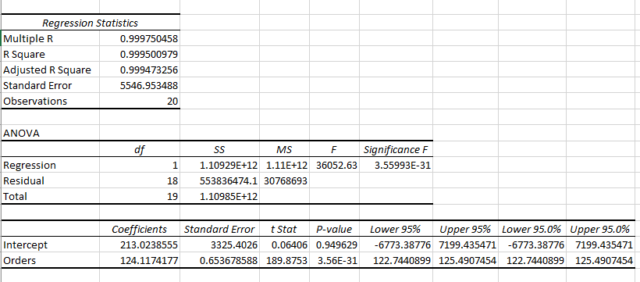
Why so similar?
Number of Orders and Sales is highly correlated.
This is how a regression between number of Orders and Sales looks like:
Notes:
^This is not insightful at all. It is actually very obvious.So what is the point of this regression? Next Slide.

Slide 63
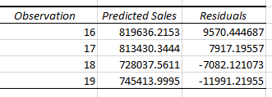
What is the point of regression then?
Outliers:
We observe the following outliers:
April, May, June and July.
In April and May, the sales predicted is significantly higher than the actual sales, implying that people spend less on every order in these months.
Whereas, in June and July, the predicted sales is significantly lower than the actual sales, implying that people spend more on every order.

Slide 64
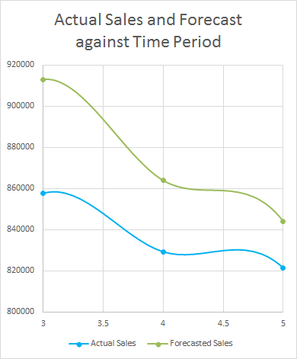
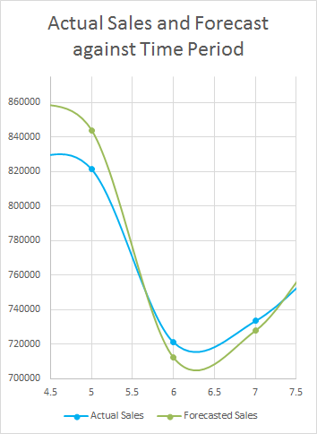
Observations from the Forecast
Notes:
Difference in the slope (gradient) of actual sales and forecasted sales is evident from the zoomed in graphs shown above.
Since we obtain the same results using two different forecasting methods (one was based on number of orders and the other one based on changes with respect to time), we can conclude that the months of April, May, June and July are indeed outliers.

